Slide 1
William Faulkner
1897 - 1962

Slide 2
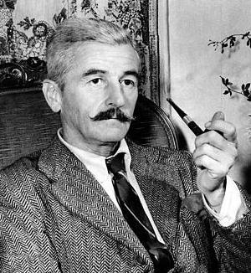

Slide 3
Southern Gothic Literature
Detailed description of setting
Psychological thriller
Isolation
Resistance to Change: culture, way of life, maturity

Slide 4
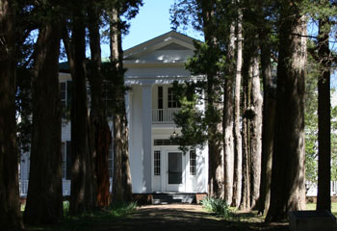

Slide 5
Faulkner’s Life
Estelle Oldham – teenage romance
Lost his chance at a proposal
Married her after her marriage of 10 years failed

Slide 6
Continued
Outwardly happy, but Faulkner always felt unfulfilled for letting her marry someone else first
Drank and had many affairs
Else Jonsson – famous affair

Slide 7
A Rose for Emily
Non-chronological time frame
5 Parts
Resistance to change
Unhealthy attachment to other people: both dad & lover

Slide 8
